Slide 1

Reading at
Somers Heath – KS1

Slide 2
Aims of the session
Understand the importance of reading
How we teach reading at Somers Heath
What reading looks like in KS1
How you can support your child at home
To observe a live Guided Reading session

Slide 3
Why reading matters
Builds confidence and enjoyment
Improves vocabulary and understanding
Supports phonics and writing
Reading underpins all learning
Creates positive routines and bonding time with your child
Little and often makes the biggest
difference!

Slide 4
How we teach reading at Somers Heath
Reading is taught during daily guided reading sessions and a weekly reading comprehension session.
Children are assessed at the end of every half term to check their progress and attainment.

Slide 5
What reading looks like in KS1
Children learn to:
-Recognise sounds and blend words
-Read common words by sight
-Build fluency and expression
-Talk about what they have read
Reading is not just sounding out
words – understanding is key

Slide 6
What reading looks like in KS1
When your child reads:
-Encourage them to sound out unfamiliar words
-Say the sounds, not letter names
-Blend sounds together slowly
E.g. sh – i – p ship
If they get stuck – pause, prompt, praise!
Tell them the word if still unsure

Slide 7
What reading looks like in KS1
*Comprehension:
-Retrieve information from a text
-Infer meaning
-Predict what might happen next
-Summarise key ideas
-Understand and explore new vocabulary

Slide 8







Strategies for reading comprehension
Use our background knowledge to connect text.
Understand and explore new vocabulary and commit to our working memory.
Predict, ask questions, I wonder- read on to find out more.
Visualise
Probing questions.
Inference.
Scan for information.
Who, what, where? It’s literally right there.
Put together to build gist.

Slide 9
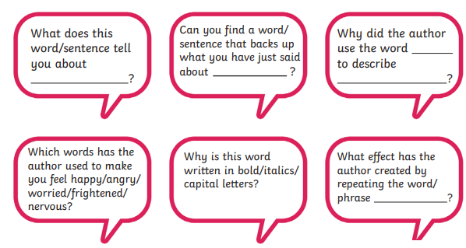
Use our background knowledge to connect text.
Understand and explore new vocabulary.
If children do not understand the meaning of key words, they will not be able to fully access a text even if they can read it accurately, it helps them to make sense of what they have read.

Slide 10
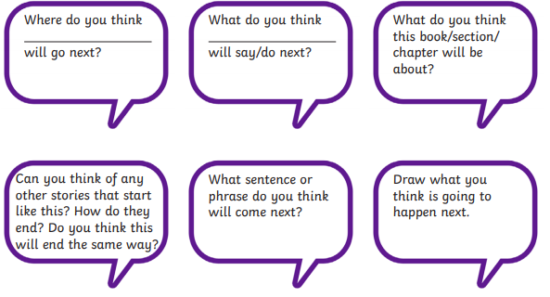
Predict, ask questions, I wonder … ,
read on to find out more.
Making predictions helps children to make sense of what they have already read and improve overall understanding of a text.

Slide 11
Visualise
After you have read a part of the text with your child, share what you were thinking or what you imagined whilst you were reading.
Ask them what they were thinking.
For example, what do you see when you read this quote from Roald Dahl’s Charlie and the Chocolate Factory:
“In the town itself, actually within sight of the house in which Charlie lived, there was an ENORMOUS CHOCOLATE FACTORY! Just imagine that! And it wasn't simply an ordinary enormous chocolate factory, either. It was the largest and most famous in the whole world!”
Support your child to immerse themselves in the story and imagine they are there themselves.

Slide 12
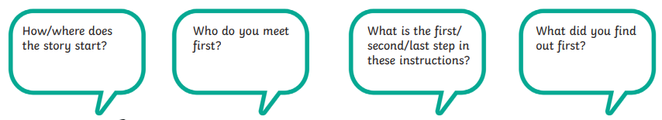
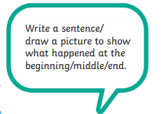
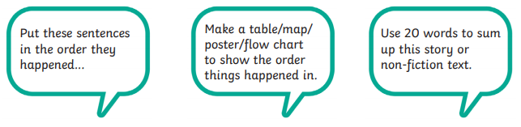
Retrieval
Put together to build gist

Slide 13
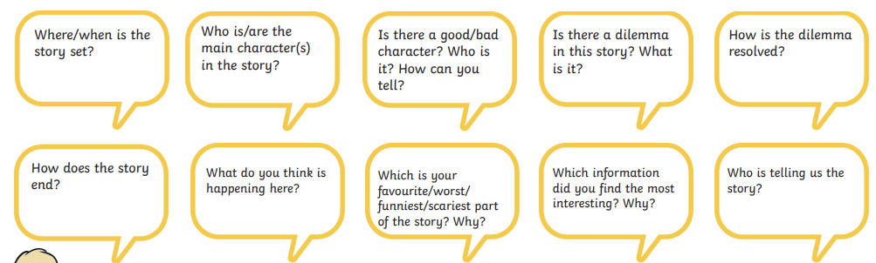
Scan for information.
Who, what, where?
It’s literally right there.

Slide 14
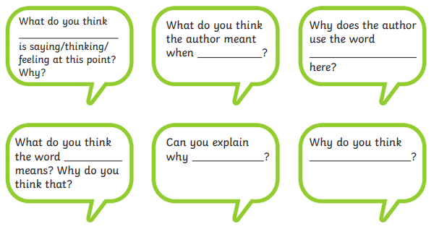
Probing questions.
Inference.
Teach children how to infer – the answers to inference questions aren’t always black and white – children need to be taught to look for clues to find answers.

Slide 15
Strategies for reading comprehension
Use our background knowledge to connect text.
Understand and explore new vocabulary and commit to our working memory.
Predict, ask questions, I wonder- read on to find out more.
Probing questions.
Inference.
Visualise
Scan for information.
Who, what, where? It’s literally right there.
Teaching children how to apply all of these skills when
reading really helps them to better understand what it is they are reading.

Slide 16
Assessment:
-Y1 Phonics Screening Check
-Y2 SATs
Along with half termly assessments, there are also statutory reading assessments the children will need to complete in KS1
Example text and questions
Phonics screening check – past paper
2025 phonics screening check pupils' materials
Y2 SATs past paper
2025 key stage 1 English reading Paper 1: reading prompt and answer booklet
2025 key stage 1 English reading Paper 2: reading booklet

Slide 17
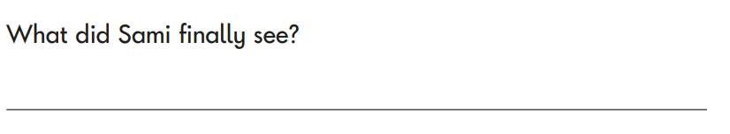
Assessment – Y2 SATs
Here this question is focussing on retrieval skills – finding the exact answer in a text

Slide 18
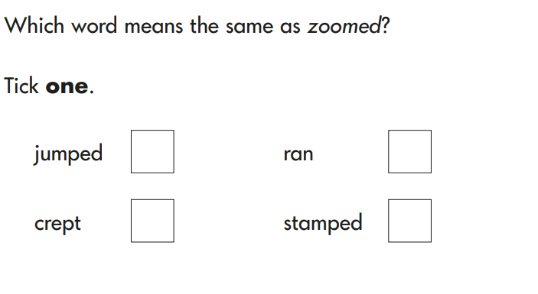
Assessment – Y2 SATs

Slide 19

Assessment – Y2 SATs

Slide 20
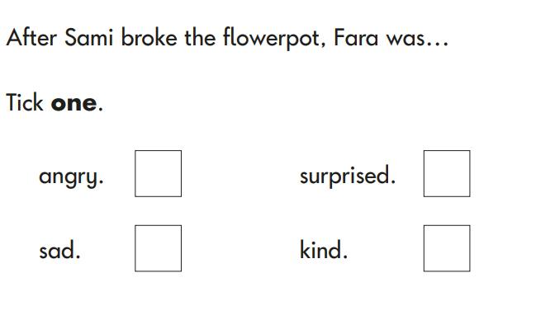
Assessment – Y2 SATs

Slide 21
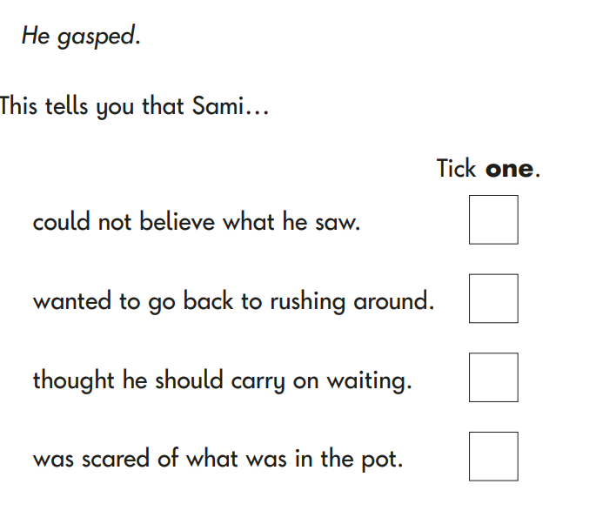
Assessment – Y2 SATs

Slide 22
How can you help your child?
Focus on an enjoyment of reading
Enjoy stories together – reading and listening just as important.
Little and often
Question children about what they have read. Talk about the story at the start, in the middle and at the end of reading. Discuss the plot, the characters (feelings and actions), how it makes you feel, predict what will happen.
Look up definitions of words together.
All reading is valuable – it doesn’t just have to be stories of the book they bring home.
We are encouraging children to read everyday
Please sign in their diaries everyday they have read and when your child has finished their book.
Complete the reading challenges!

Slide 23
How to encourage reluctant readers
Normalise mistakes during reading
Model reading to your child
Praise effort, not speed
Choose a text that interests them
Shorter sessions (longer sessions can feel overwhelming)
Build stamina gradually
Daily reading routines (e.g. same time each day)
Connect reading to real life (recipes, maps, game manuals, solving problems/completing challenges)
Use technology (ebooks, audiobooks alongside the text, reading apps)

Slide 24
Useful websites
www.wordsforlife.org.uk (National Literacy Trust)
https://www.booktrust.org.uk/
https://www.bbc.co.uk/cbeebies/shows/bedtime-stories
https://www.oxfordowl.co.uk/home/reading

Slide 25
Guided reading sessions
Daily sessions
High quality texts
Questions are prepared before the session
Reading skills are taught, with time to apply these skills

