Slide 1

Year 4 multiplication check
Successful Learners Confident Individuals Responsible Citizens

Slide 2
What is the multiplication check?
The purpose of the MTC is to determine whether pupils can recall their times tables fluently, which is essential for future success in mathematics.
It will help schools to identify pupils who have not yet mastered their times tables, so that additional support can be provided.
It is an on-screen check consisting of 25 times table questions. This can be completed on a school’s PC, Laptop or Tablets.
Your child will be able to answer 3 practice questions before taking the actual check. They will then have 6 seconds to answer each question. On average, the check should take no longer than 5 minutes to complete.

Slide 3
when IS THE MULTIPLICATION CHECK?
Schools have a two-week window to complete the check, starting on June 1st 2026

Slide 4
Why are times tables important?
Times tables are fundamental to support children and under pin everything within Maths.
It is vital that all children know their multiplication facts up to 12 x 12.
Memorising times tables makes it far quicker and easier for children to work out maths problems in their heads. ... This will help them to solve questions involving multiplication, addition, subtraction and division in their head, making the act of memorising multiplications a very worthwhile cause!

Slide 5
Ways to practice
https://mathsframe.co.uk/en/resources/resource/477/Multiplication-Tables-Check
https://www.timestables.co.uk/multiplication-tables-check/
TTRS

Slide 6

How to support my child.
https://www.gov.uk/government/publications/multiplication-tables-check-information-for-parents
We would love for your children to practise with you at home so that they feel confident when completing the test.
Learn timetable songs – there are lots of YouTube and is a great way to start learning new tables.
Use a stopwatch to time each other answering quick fire calculations.
Encourage children to play Times table Rockstars as often as possible. Small 10 minute daily sessions will help children to learn times tables more than one long session a week. The soundcheck is very similar to the multiplication check.

Slide 7
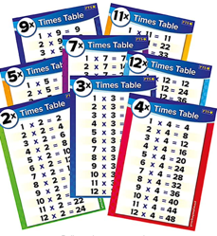
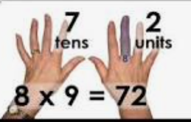
Ways to help my child
Chanting their times table is an excellent way to learn them. They could do this each time they walk up the stairs.
Display a pos
ter with all of the times tables facts on at home
Create flash cards with your children and let them play with friends, siblings, grandparents. They could write the answer on the back and test themselves.

Slide 8
Your turn

