Slide 1
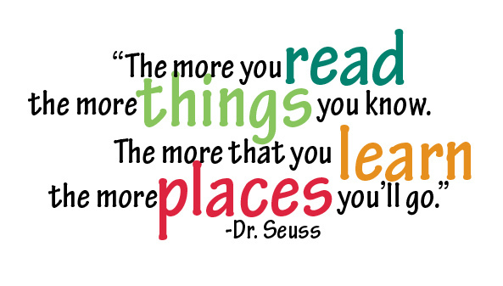
Reading at
Somers Heath – KS2

Slide 2
Aims of the session
Understand the importance of reading
How we teach reading at Somers Heath
What reading looks like in KS2
How you can support your child at home
To observe a live Guided Reading session

Slide 3
Why reading matters
Reading underpins all learning
Understand instructions better
Access maths and topic work more easily
Build’s vocabulary and confidence
Develops an enjoyment for reading
Reading 10-15 minutes each day makes
a huge difference!

Slide 4
How we teach reading at Somers Heath
Reading is taught during daily guided reading sessions and a weekly reading comprehension session.
Children are assessed at the end of every half term to check their progress and attainment.

Slide 5
What reading looks like in KS2
Children move from ‘learning to read’ to ‘reading to learn’.
*Reading fluency –
Reading accurately, at an appropriate speed, using expression and reading aloud confidently to others. Fluent readers can focus on understanding the text, not just decoding words.

Slide 6
What reading looks like in KS2
*Vocabulary development–
Understand new and ambitious words, use context clues to work out meanings, recognise how words change meaning depending on context, apply new vocabulary when speaking and writing.

Slide 7
What reading looks like in KS2
*Being exposed to a wide range of texts–
-Stories, novels and traditional tales
-Non-fiction (reports, explanations, biographies)
-Poetry
-Playscripts
-Digital texts
Children learn how texts are structured, why
authors choose different formats and how purpose
and audience affect writing.

Slide 8
What reading looks like in KS2
*Comprehension–
-Retrieve information from a text
-Infer meaning
-Predict what might happen next
-Summarise key ideas
-Explain and justify answers using evidence from the text

Slide 9







Strategies for reading comprehension
Use our background knowledge to connect text.
Understand and explore new vocabulary and commit to our working memory.
Predict, ask questions, I wonder- read on to find out more.
Visualise
Probing questions.
Inference.
Scan for information.
Who, what, where? It’s literally right there.
Put together to build gist.

Slide 10
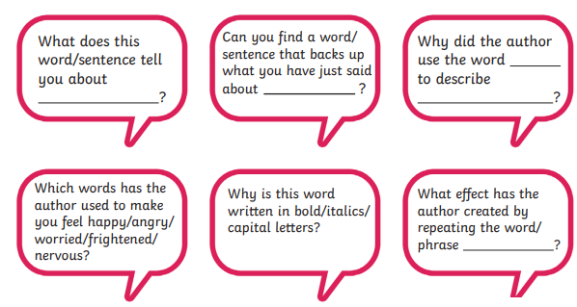
Use our background knowledge to connect text.
Understand and explore new vocabulary.
If children do not understand the meaning of key words, they will not be able to fully access a text even if they can read it accurately, it helps them to make sense of what they have read.

Slide 11
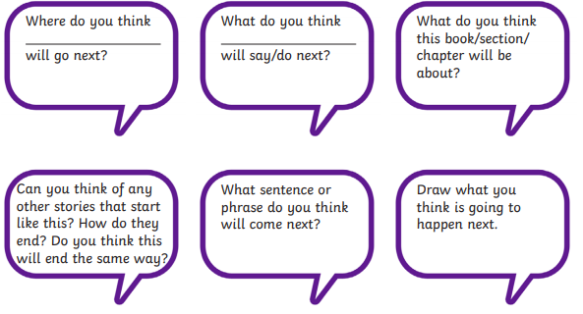
Predict, ask questions, I wonder … ,
read on to find out more.
Making predictions helps children to make sense of what they have already read and improve overall understanding of a text.

Slide 12
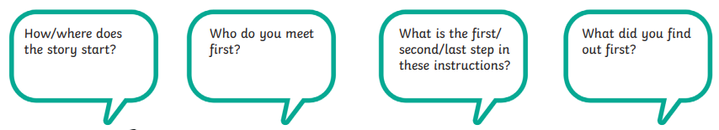
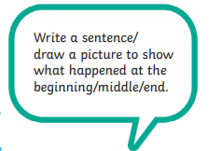
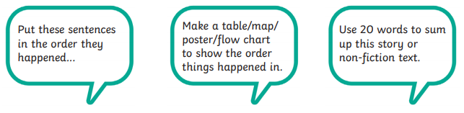
Retrieval

Slide 13
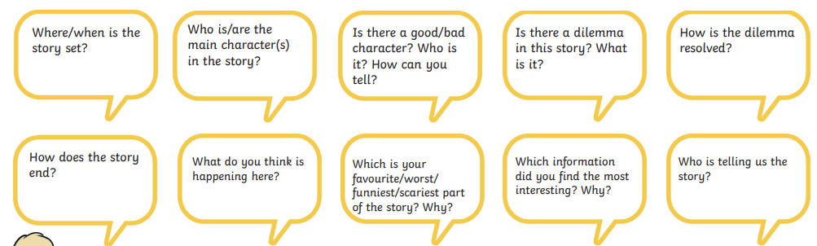
Scan for information.
Who, what, where?
It’s literally right there.

Slide 14
Visualise
After you have read a part of the text with your child, share what you were thinking or what you imagined whilst you were reading.
Ask them what they were thinking.
For example, what do you see when you read this …
“The fog crept slowly across the playground at night, wrapping itself around the old oak tree. The swing chains creaked as they rocked back and forth, even though there was no wind. A single light glowed in the classroom, flickering as shadows moved past the window. Somewhere nearby, gravel crunched under careful footsteps, then everything fell silent again”.
Support your child to immerse themselves in the story and imagine they are there themselves.

Slide 15
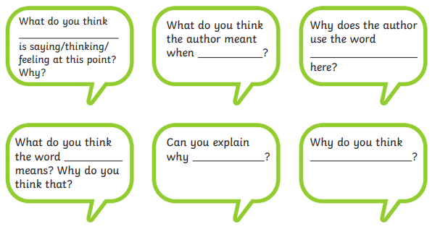
Probing questions.
Inference.
Teach children how to infer – the answers to inference questions aren’t always black and white – children need to be taught to look for clues to find answers.

Slide 16
EXAMPLE QUESTIONS
When Tim drew back his sitting-room curtains, he saw the ruined flowerbeds and he was furious.
'Oh! Not again!' Mary said when he went into the kitchen and told her.
Tim set off to speak to Mr. Jackson about the flock getting out and doing more damage.
'This time,' Tim thought, 'I shall ask him to tidy it all up and pay for new plants.'
Retrieval: What did Tim do in the sitting-room?
Inference: What sort of creature walked on the flowers? Find evidence to explain your answer.
Vocabulary: Which word shows that Tim is angry?
Vocabulary: Find a word that means damaged.
Organisation: Why did the author use exclamation marks
in the second sentence?

Slide 17
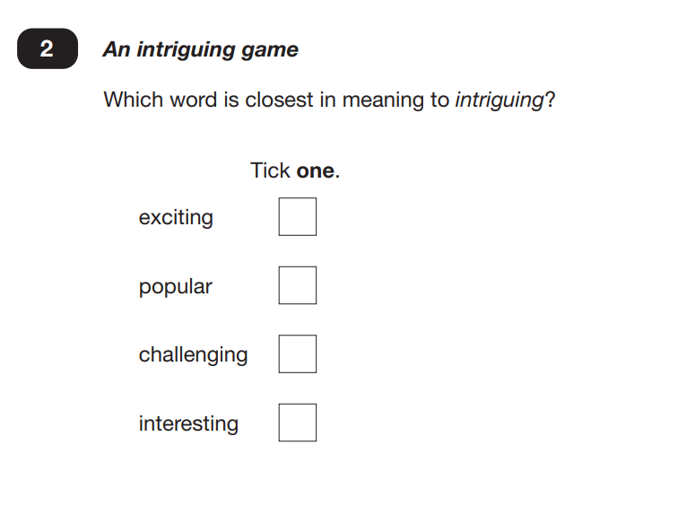
Assessment – Y6 SATs
Example text and questions
2025 KS2 English reading booklet
Along with half termly assessments, there are also statutory reading assessments the children will need to complete at the end of KS2

Slide 18
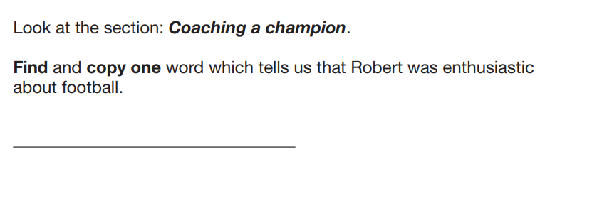
Assessment – Y6 SATs
Example questions

Slide 19
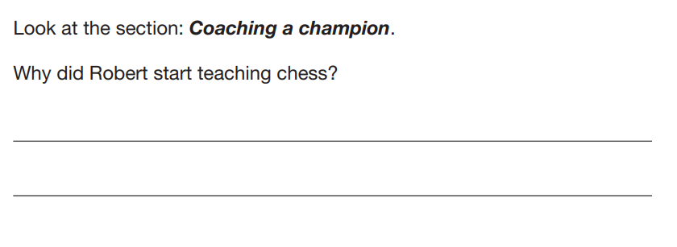
Assessment – Y6 SATs
Example questions

Slide 20
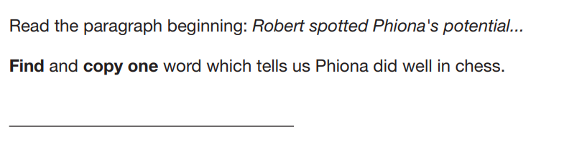
Assessment – Y6 SATs
Example questions

Slide 21
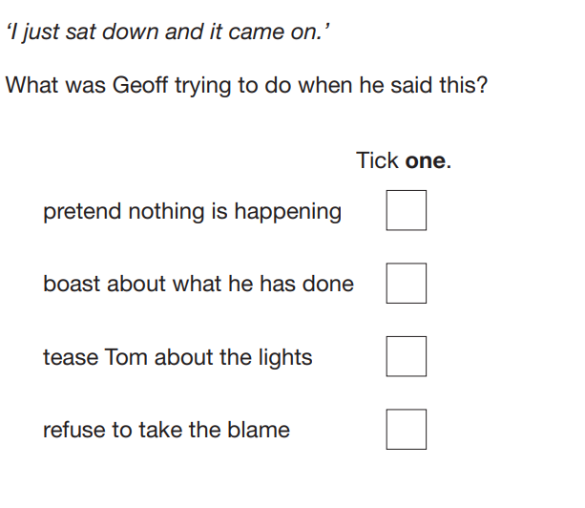
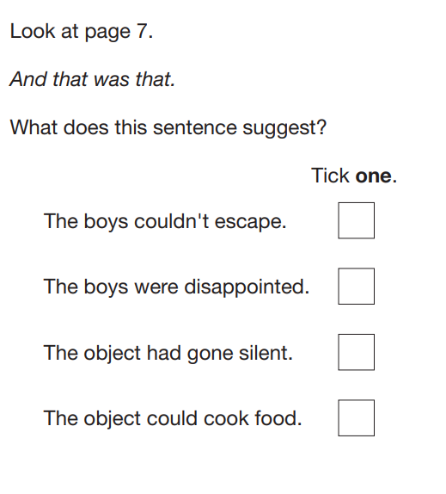
Assessment – Y6 SATs
Example questions

Slide 22
How can you help your child?
Focus on an enjoyment of reading
Enjoy stories together – reading and listening just as important.
Little and often
Question children about what they have read. Talk about the story at the start, in the middle and at the end of reading. Discuss the plot, the characters (feelings and actions), how it makes you feel, predict what will happen.
Look up definitions of words together.
All reading is valuable – it doesn’t just have to be stories of the book they bring home.
We are encouraging children to read everyday and have this signed by an adult
Please sign in their diaries everyday they have read and when your child has finished their book.
Complete the reading challenges!

Slide 23
How to encourage reluctant readers
Model reading to your child
Normalise mistakes during reading
Praise effort, not speed
Choose a text that interests them
Shorter sessions (longer sessions can feel overwhelming)
Build stamina gradually
Daily reading routines (e.g. same time each day)
Connect reading to real life (recipes, maps, game manuals, solving problems/completing challenges)
Use technology (ebooks, audiobooks alongside the text, reading apps)

Slide 24
Useful websites
www.wordsforlife.org.uk (National Literacy Trust)
https://www.booktrust.org.uk/
https://www.oxfordowl.co.uk/home/reading

Slide 25
Guided reading sessions
Daily sessions
High quality texts
Questions are prepared before the session
Reading skills are taught, with time to apply these skills

